Slide 1

A. P. Shah Institute of Technology
International Conference on Innovations in Computer Technology and Applications (IC2TA-2019)
Eye Control System Based on Hough Transform Algorithm
/home/apsit/Desktop/iCASTE-2019/ICASTe-2018 PPT Template-Civ.ppt

Slide 2
Presented by -
Anindita Chowdhury
Vibha Gaikwad
Anamika Sonavane
IC2TA-2019

Slide 3
Outline of Presentation
Abstract
Introduction
Literature Review
Problem Statement / Problem Definition
Proposed System
Implementation / Technologies Used
Result Discussion
Conclusion
IC2TA-2019

Slide 4
ABSTRACT
This paper presents an eye control system that utilizes eye gaze tracking techniques that might be helpful for limb disabled and/or speech impaired people with healthy eyes, to interact with the digital world.
Functionalities
A motion function where eye gaze position is used to control mouse movement to control mouse movement
A blink detection function used to simulate a mouse click.
IC2TA-2019

Slide 5
INTRODUCTION
More than 1 billion people in the world have some form of disability. This corresponds to about 15% of the world's population.
Census 2001 has revealed that over 21 million people in India are suffering from one or the other kind of disability. This is equivalent to 2.1% of the population.
Due to their limb handicap, such a vast amount of people cannot enjoy the convenience and entertainment of the ever-advancing computer technology.
So, this paper has a purpose of meeting the specific needs of these limb disabled people.
IC2TA-2019

Slide 6
LITERATURE REVIEW
One of the earliest eye-trackers was designed by Edmund Huey (Huey, 1908) which just consisted of a contact lens like device with a hole for the pupil.
The first non-intrusive eye trackers were built by Guy Thomas Buswell in Chicago, using beams of light that were reflected on the eye and then recording them on film.
In 2006 a group of Taiwanese engineers developed a "Powered Wheelchair controlled by Eye Tracking system".
In 2016, a comparative study of user experience in online-social media branding web pages using eye-tracker was conducted
IC2TA-2019

Slide 7
PROBLEM STATEMENT
This project uses tracking of the eye gaze position and eye-state (staring or blinking) for enabling virtual mouse, so as to make it possible for limb-disabled people to experience the digital world. The image frames of eye pupil captured from webcam will be processed using greyscale conversion, smoothing filters, canny-edge detection, which will be used to detect pupil centre using Hough transform algorithm. Eye Gaze position is used for mouse movement and blinking is used for a mouse click. If the blink duration exceeds 2 seconds, then it will be considered as a click, otherwise not.
IC2TA-2019

Slide 8
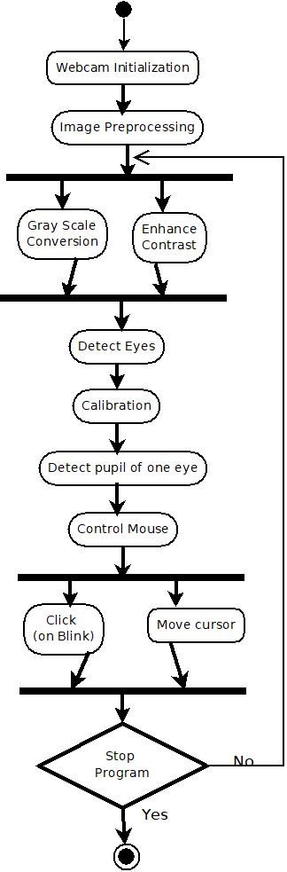
PROPOSED
SYSTEM
IC2TA-2019

Slide 9
IMPLEMENTATION / TECHNOLOGIES
USED
Windows Operating System, Windows 7 Professional.
Visual Studio 2015 Community version : Microsoft Visual Studio is an integrated development environment (IDE) from Microsoft. It is used to develop computer programs, as well as websites, web apps, web services and mobile apps and it supports 36 different programming languages.
Open CV with C++ : Open CV (Open Source Computer Vision) is a library of programming functions mainly aimed at real-time computer vision.
IC2TA-2019

Slide 10
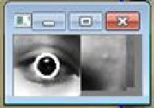
RESULT ANALYSIS
Fig. Result of iris detection of the left eye
IC2TA-2019

Slide 11
CONCLUSION
Future Advancements
Improvement of the pupil localization method in order to make the coordinates transform more accurate using Purkinje images
Increasing the precision i.e. the system should accurately identify and click any button of the computer system, no matter how small it is.
Transplanting the system from PC platform to the mobile platform. This can also be made more accurate with the help of a VR gear.
IC2TA-2019

Slide 12
QUESTIONS ?
IC2TA-2019

Slide 13
THANK YOU!
IC2TA-2019

